Slide 1
Product Management
Step by step how to build it

Slide 2
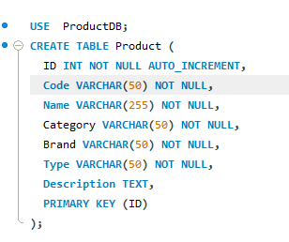
Set up Database
Set Up database using MySQL
Create DB called ProductDB
Create Table with its fields like depicted below

Slide 3
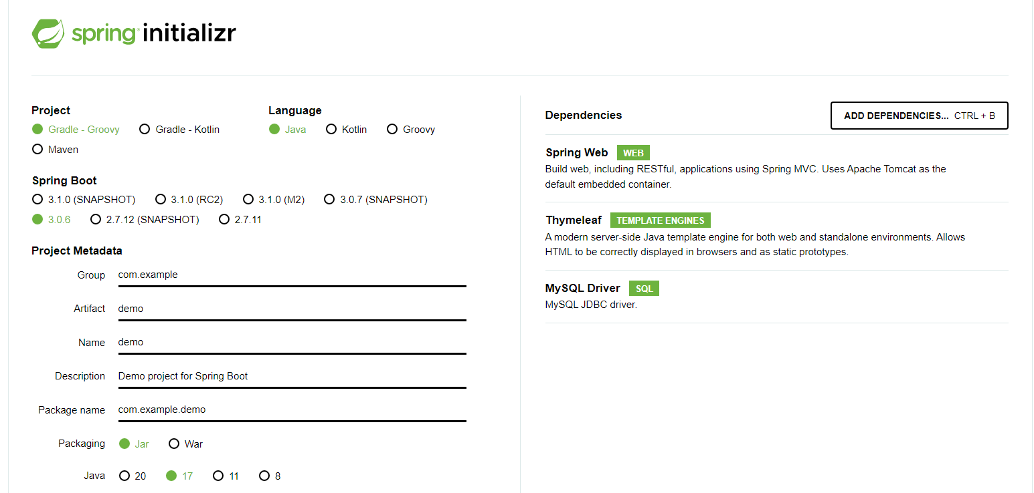
Initialize Springboot
Visit https://start.spring.io/
Set the parameter and choose the dependencies

Slide 4
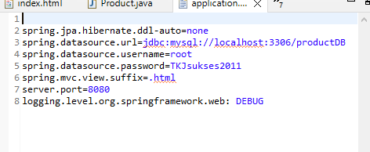
Set up Application.Properties
Set the Application Properties to connect DB and enable HTML suffix

Slide 5
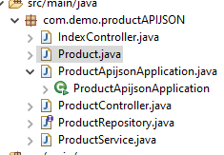
Create Java Files
Create Java Files including
Model
Repository
Controller
Service

Slide 6
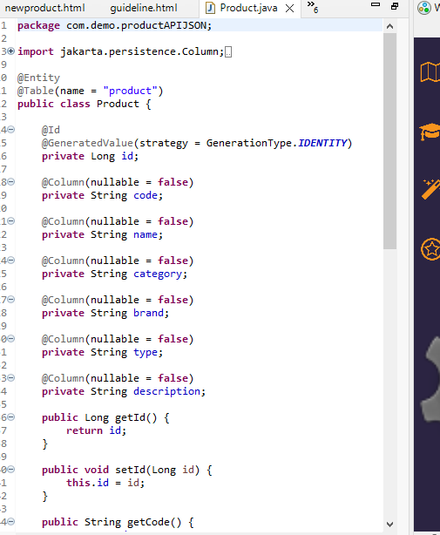
Create Java Model Class
Add required attributes
Add getters and setters

Slide 7
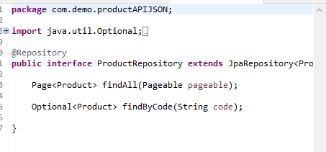
Create the Repository Class
Extends JpaRepository
Define additional methods if needed

Slide 8
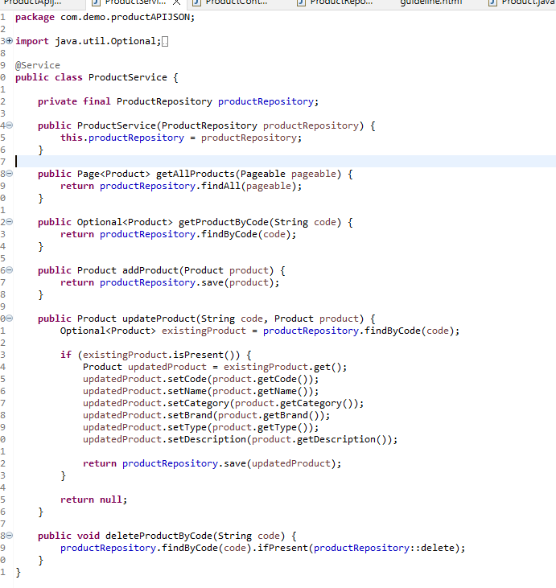
Define Service Class
Define each required service

Slide 9
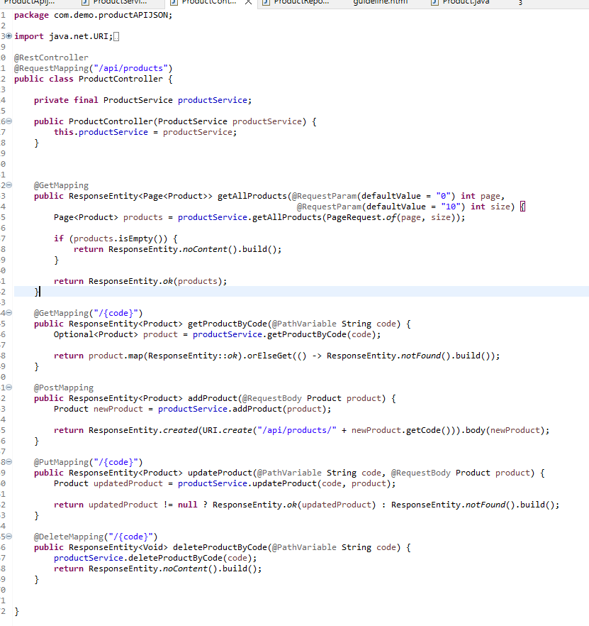
Create Controller Class
Define each request path

Slide 10
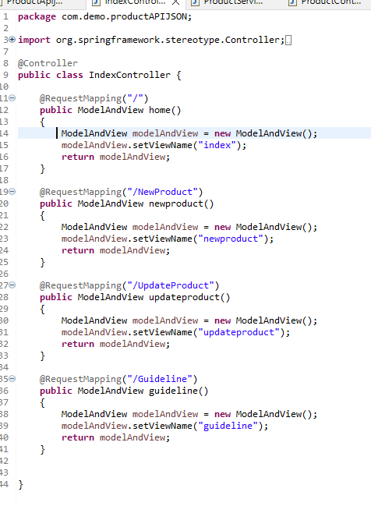
Define Controller class for HTML

Slide 11
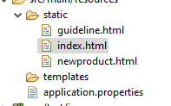
Create HTML File

Slide 12

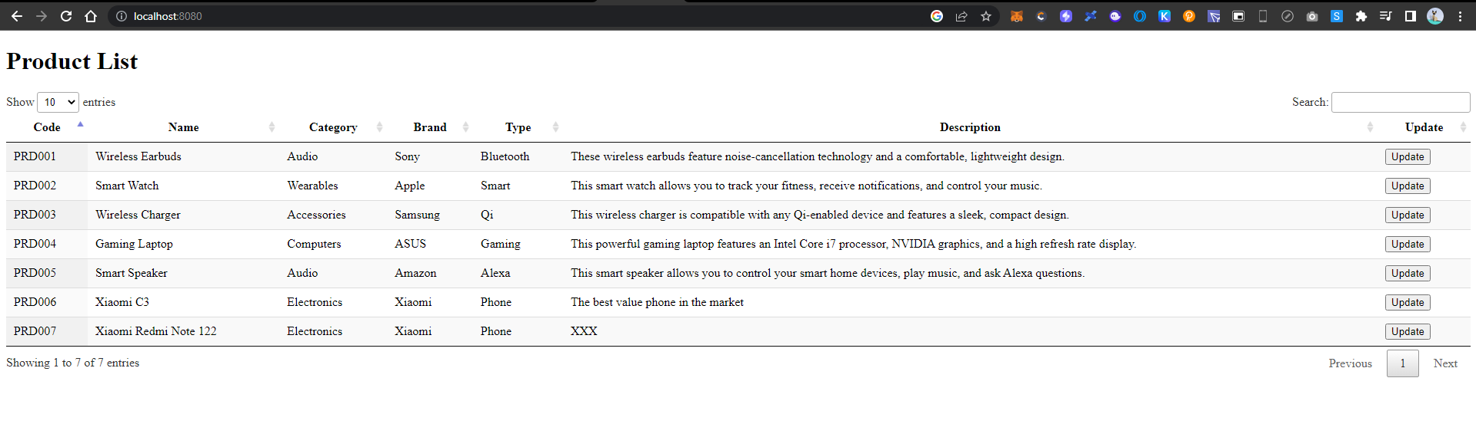
Run the Java Application and access via browser

